Slide 1

KS3 Mathematics
D4 Probability Diagrams
Notes:
The aim of this unit is to teach pupils to:
Use the vocabulary of probability
Use the probability scale; find and justify theoretical probabilities
Collect and record experimental data, and estimate probabilities based on the data
Compare experimental and theoretical probabilities
Material in this unit is linked the Framework’s supplement of examples pp276–285.

Slide 2


Finding all possible outcomes of two events
Two coins are thrown.
What is the probability of getting two heads?
Before we can work out the probability of getting two heads we need to work out the total number of equally likely outcomes.
There are three ways to do this:
1) We can list them systematically.
Using H for heads and T for tails, the possible outcomes are:
TH and HT are separate equally likely outcomes.
TT,
TH,
HT,
HH.
Notes:
Stress that when there is more than one event it is important to list all the possible outcomes systematically.
Listing the outcomes systematically means listing them in a logical order to make sure that none are left out.
Explain that TH means, ‘a tail on the first coin and a head on the second’ and that HT means, ‘a head on the first coin and a tail on the second’. These are therefore two separate events.

Slide 3
Finding all possible outcomes of two events
2) We can use a two-way table.
Second coin
H
T
First
coin
H
HH
HT
T
TH
TT
From the table we see that there are four possible outcomes one of which is two heads so,
1
P(HH) =
4

Slide 4
Finding all possible outcomes of two events
3) We can use a probability tree diagram.
Outcomes
Second coin
H
HH
First coin
H
T
HT
H
TH
T
T
TT
Again we see that there are four possible outcomes so,
1
P(HH) =
4

Slide 5
Finding the sample space
A red dice and a blue dice are thrown and their scores are added together.
What is the probability of getting a total of 8 from both dice?
There are several ways to get a total of 8 by adding the scores from two dice.
We could get a 2 and a 6,
a 3 and a 5,
a 4 and a 4,
a 5 and a 3,
or a 6 and a 2.
To find the set of all possible outcomes, the sample space, we can use a two-way table.
Notes:
Stress that although we know that there are 5 different ways of getting a total of 8, we can’t find the probability of getting a total of 8 unless we know the total number of possible outcomes (the sample space). To find these we draw a two-way table as shown on the next slide.

Slide 6
Finding the sample space
+
From the sample space we can see that there are 36 possible outcomes when two dice are thrown.
2
3
4
5
6
7
3
4
5
6
7
8
8
4
5
6
7
8
9
8
5
6
7
8
9
10
8
Five of these have a total of 8.
6
7
8
8
9
10
11
5
P(8) =
7
8
36
8
9
10
11
12
Notes:
As the two-way table is completed ask pupils what patterns they notice.
Use the completed table to justify that the probability of the total score on the two dice being 8 is ⁵/₃₆.
Ask pupils to use the table to give the probabilities of other scores such as:
P(3)
P(a score less than 7)
P(an even score)
P(a score that is prime)
P(a score that is square)
Ask pupils to cancel down any fractions if possible.

Slide 7
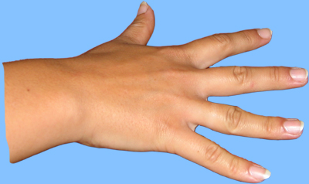

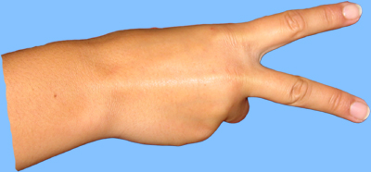
Scissors, paper, stone
In the game scissors, paper, stone two players have to show either scissors, paper, or stone using their hands as follows:
scissors
paper
stone
The rules of the game are that:
Scissors beats paper (it cuts).
Paper beats stone (it wraps).
Stone beats scissors (it blunts).
If both players show the same hands it is a draw.

Slide 8
Scissors, paper, stone
What is the probability that both players will show the same hands in a game of scissors, paper, stone?
We can list all the possible outcomes in a two-way table using S for Scissors, P for Paper and T for sTone.
Second player
Scissors
Paper
Stone
Scissors
SS
SP
ST
SS
First player
Paper
PS
PP
PP
PT
Stone
TS
TP
TT
TT
3
1
P(same hands) =
=
9
3

Slide 9
Scissors, paper, stone
What is the probability that the first player will win a game of scissors, paper, stone?
Using the two-way table we can identify all the ways that the first player can win.
Second player
Scissors
Paper
Stone
Scissors
SP
SS
SP
ST
First player
Paper
PS
PP
PT
PT
Stone
TS
TP
TT
TS
3
1
P(first player wins) =
=
9
3
Notes:
Remember the rules of the game:
Scissors beats paper; paper beats stone; stone beats scissors.

Slide 10
Scissors, paper, stone
What is the probability that the second player will win a game of scissors, paper, stone?
Using the two-way table we can identify all the ways that the second player can win.
Second player
Scissors
Paper
Stone
Scissors
SP
ST
SS
ST
First player
Paper
PS
PP
PT
PS
Stone
TS
TP
TT
TP
3
1
P(second player wins) =
=
9
3
Notes:
Remember the rules of the game:
Scissors beats paper; paper beats stone; stone beats scissors.

Slide 11
Scissors, paper, stone
Is scissors, paper, stone a fair game?
1
P(first player wins) =
3
1
P(second player wins) =
3
1
P(a draw) =
3
Both players are equally likely to win so, yes, it is a fair game.
Play scissors paper stone 30 times with a partner.
Record the number of wins for each player and the number of draws. Are the results as you expected?
Notes:
Review what is meant by a fair game. In a fair game all players are equally likely to win.
Allow pupils to play the game in pairs and to record their results.
Discuss the fact that in 30 games we would expect to get 10 wins for the first player, 10 wins for the second player and 10 draws. Discuss why this does not happen in reality.

